Slide 1
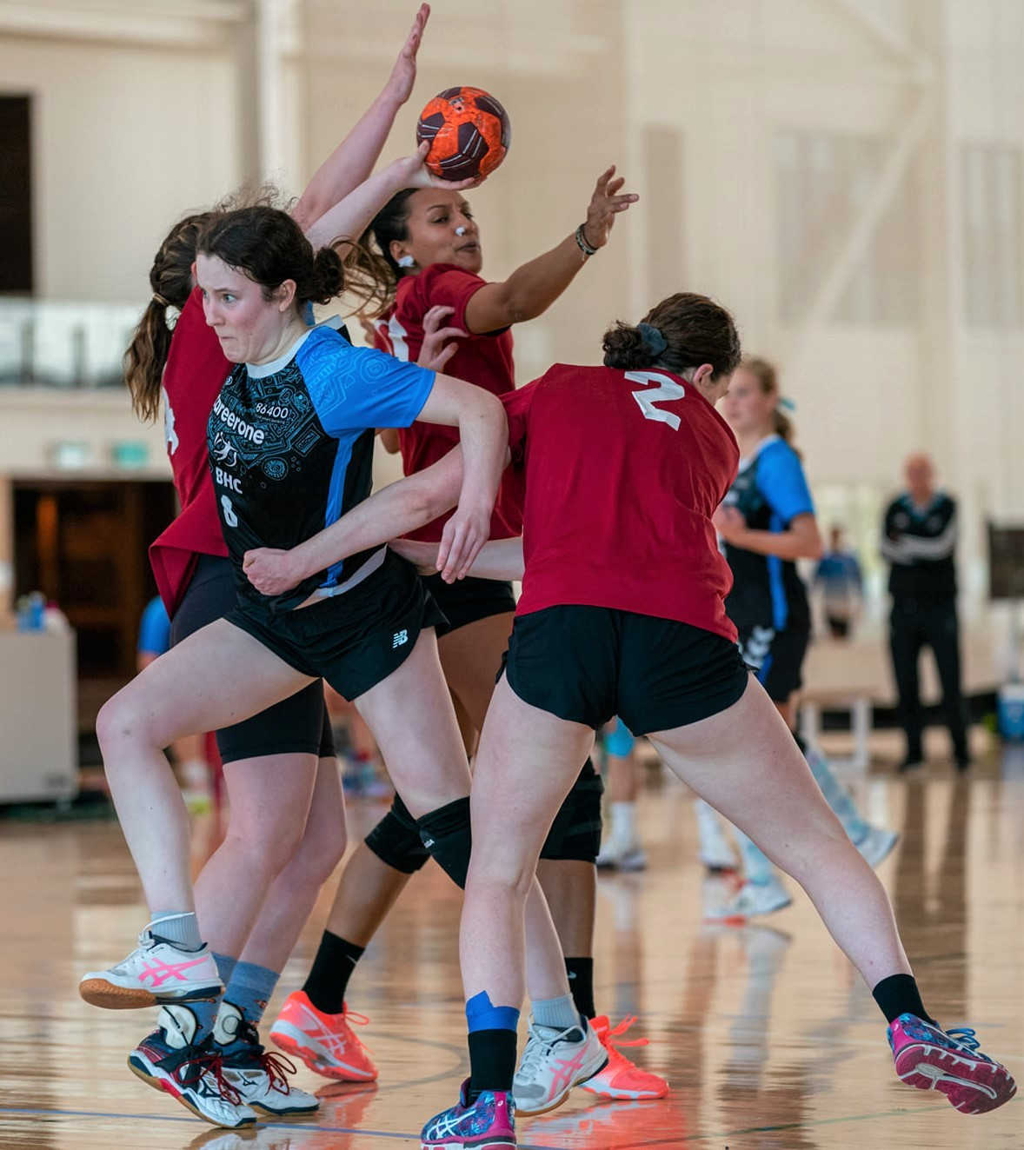

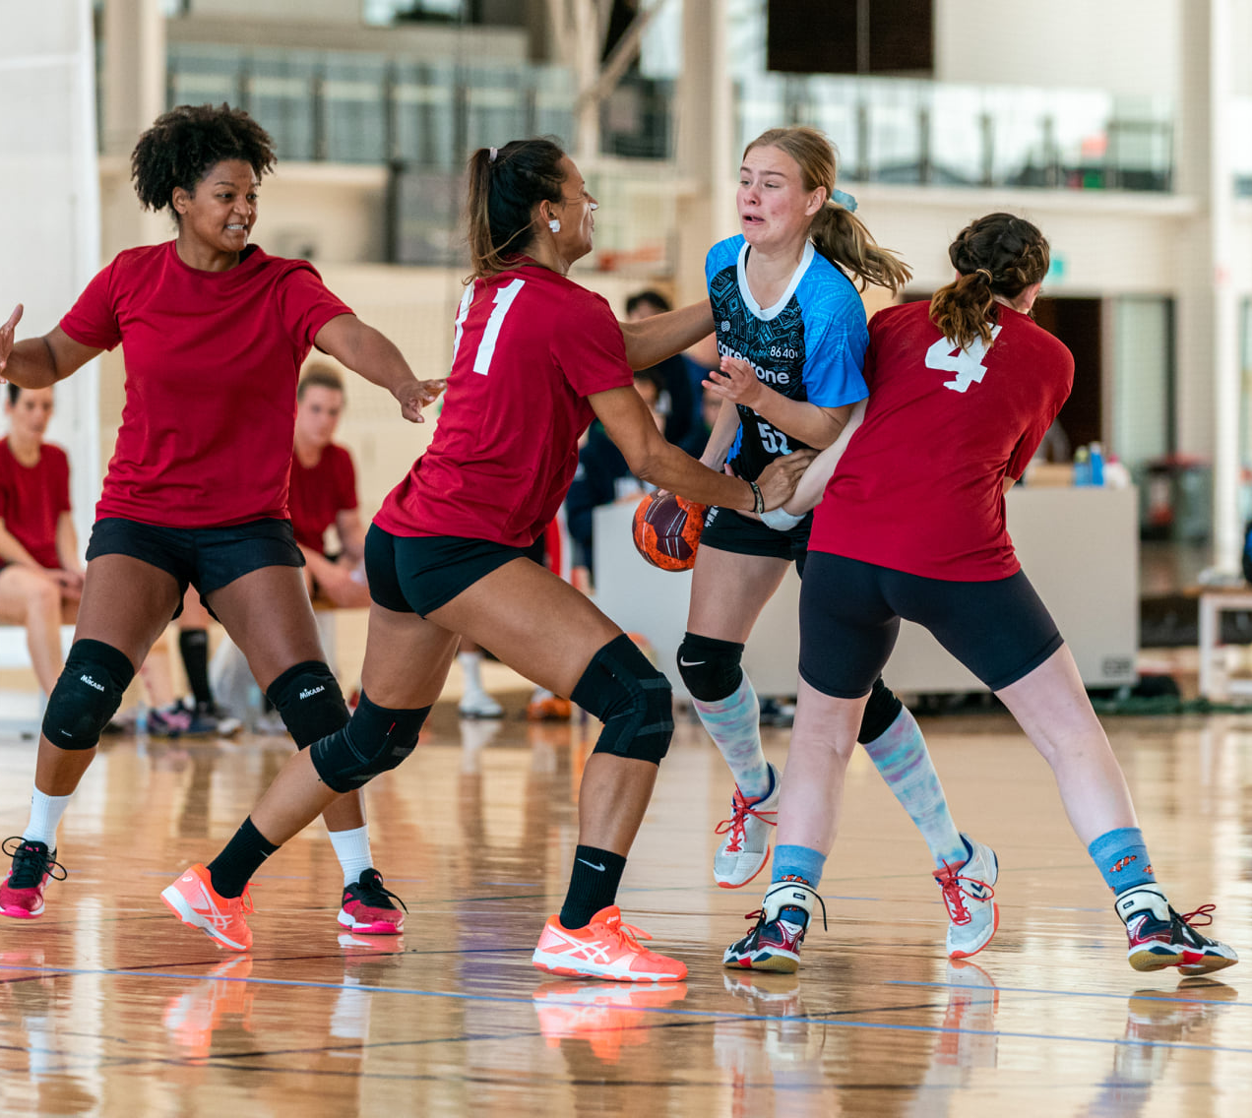

Handball Queensland
Gender equity - commitment strategy
Queensland Team Handball Association Inc

Slide 2
No boundaries for women and girls in sport and physical activity
Community Sport is a powerful catalyst for social change; it can help shape community attitudes and perspectives and plays a crucial role in advancing gender equality and challenging gender stereotypes.
Sport teaches that women and girls can be strong, powerful and competitive, and paints these traits as healthy and normal, helping to redefine gender norms. Additionally, strong, powerful female role models increase the interest and participation of women in sport.
Research shows that promoting women’s engagement in sport as players and spectators, coaches and administrators, strengthens community connection and social cohesion while also leading to a decrease in poor and anti-social behaviours at sporting events.
Handball Queensland

Slide 3
Advance more women into leadership positions and develop respectful and inclusive sporting cultures
Questions for HQ
Is there gender balance in leadership across the organisation?
Do the conditions and culture enable women to thrive in sport organisations?
Is there a flexible and inclusive experience?
Is there a strategy for maintaining gender equity on the Management Committee and in leadership in HQ?
Focus area - Leadership

Slide 4
Current Management Committee
Queensland Team Handball Association Inc (QTHA).
President: Susan Wilson-Gahan
Treasurer: Linda Reid
Secretary: Michelle Jory
Vice President: James Korthal
Beach Handball Delegate: Tanya Beths
Director of Coaching: Juan Santiago Diaz Granada
Referee Convernor: Max Illing

Slide 5
Handball Queensland
Handball Queensland is committed to the following principles
maintaining gender equity in the organisation structure and leadership
developing a new strategic plan that includes a focus on equity for women and girls in sport in line with the ‘National Policy Framework for Girls and Women in Sport 2030’.
strong gender balanced leadership to enable real change.
developing policies, programs, and design structures to ensure gender equity in coaching, officiating, administration, and committee and Board membership.
Gender equity in decision making at all levels including recruitment, development and retention
Gender equality in sport benefits women and girls, our businesses, our communities, and Australia.

