Slide 1

Handball Queensland Mini Handball lessons
Web: https://www.handballqld.com.au/
Facebook: https://www.facebook.com/HandballQueensland
E: handballqld@gmail.com

Slide 2
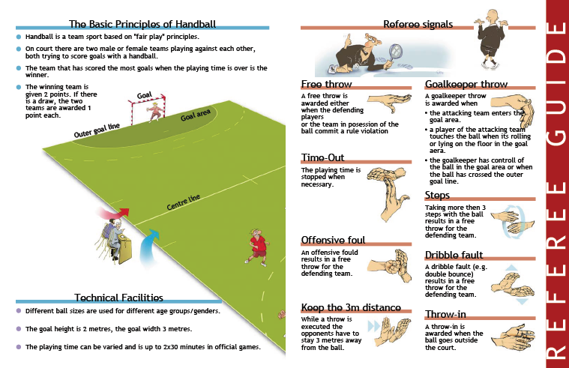
Mini-handball rules

Slide 3
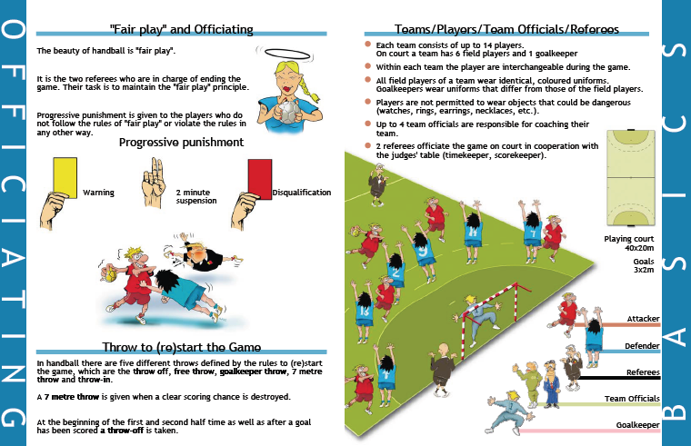
Mini-handball rules

Slide 4
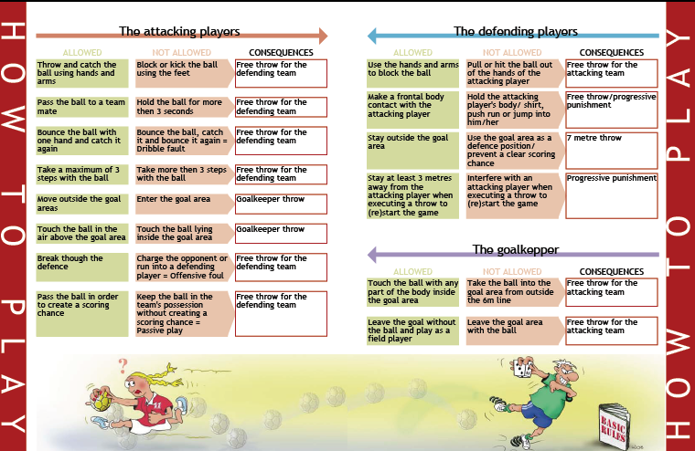
Mini-handball rules

Slide 5
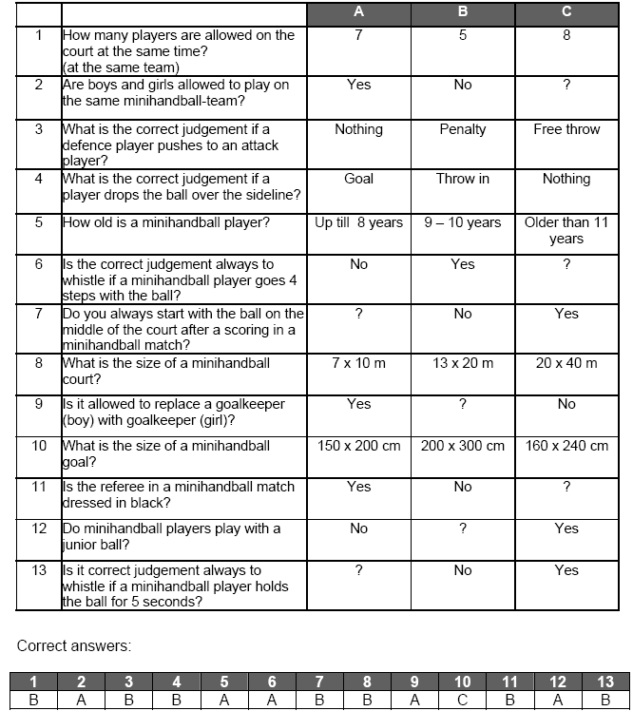
Mini-handball rules Quiz

Slide 6
Mini-Handball Court
Mark it indoors or outdoors on the wood floor, flex-floor, grass, blacktop, sand, etc.
Adapt to your available space.
7m
Solid red line shows the area in which pressing could be allowed against attacking team
Goal area: a semi-circle of 5m or 16ft radius
Free-throw Line: a semi-circle 7m or 22.5ft radius
Goal: 1.6m (5’4”) high by 2.4m (8’) wide or regular goal but with a lower cross bar or floor hockey goal or substitute it with 2 long wooden sticks inserted into large floor cones/markers
1.6m
2.4m
12-16m
wide
or
40-54ft
5m
7m
20-24m long or 67-80ft

Slide 7
Mini-Handball – Two Ways to Play
One (1) goalie plus 4/5 court players
(no zone restriction)
One (1) goalie plus 4/5 players in zones (2+2 or 2+3 in restricted zones)
In this version, all 4 or 5 players can run and play freely in both parts of the court with no restrictions. Players rotate between goal and court positions.
In this version, players’ movements are restricted to within either offensive or defensive halves. Players rotate between goal, defense and offense.

Slide 8
Teaching Mini-Handball – Fun Phase
Key Developmental Stages
Target Motor Functions & Skills
Me & the Ball
Age: 6-7
Me & My Friends
Age: 8-9
Us & Others
Age: 10
Roll – Creep - Crawl
Walk – Run (forward/backward/zigzag)
Hop one one & both feet
Skip - Shuffle
Push - Pull
Jump horizontally & vertically (on one & both feet
Balance – Fall (various surfaces)
Roll with small objects
Throw & Kick & Dribble (both hands/legs)
Pass & Catch
Sportsmanship & Cooperation
Self-Esteem & Confidence

Slide 9
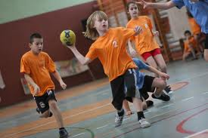
Mini-Handball – Single Lesson
Part 1 (5-10-15 min.)
Part 2 (20-30-40 min.)
Part 3 (5-10 min.)
Meet & Greet, Attendance
Warm-up including stretching
Cool-down including stretching
Wrap-up, Praise Effort/Attitude, Inform,
Practice motor and sport skills through mass exercises, lead-up games and mini-handball
Goals & Objectives Explained
Dismiss
Length: 30-45-60 minutes
One Coach per 10-12 kids
Learning and having fun through playing games.

Slide 10
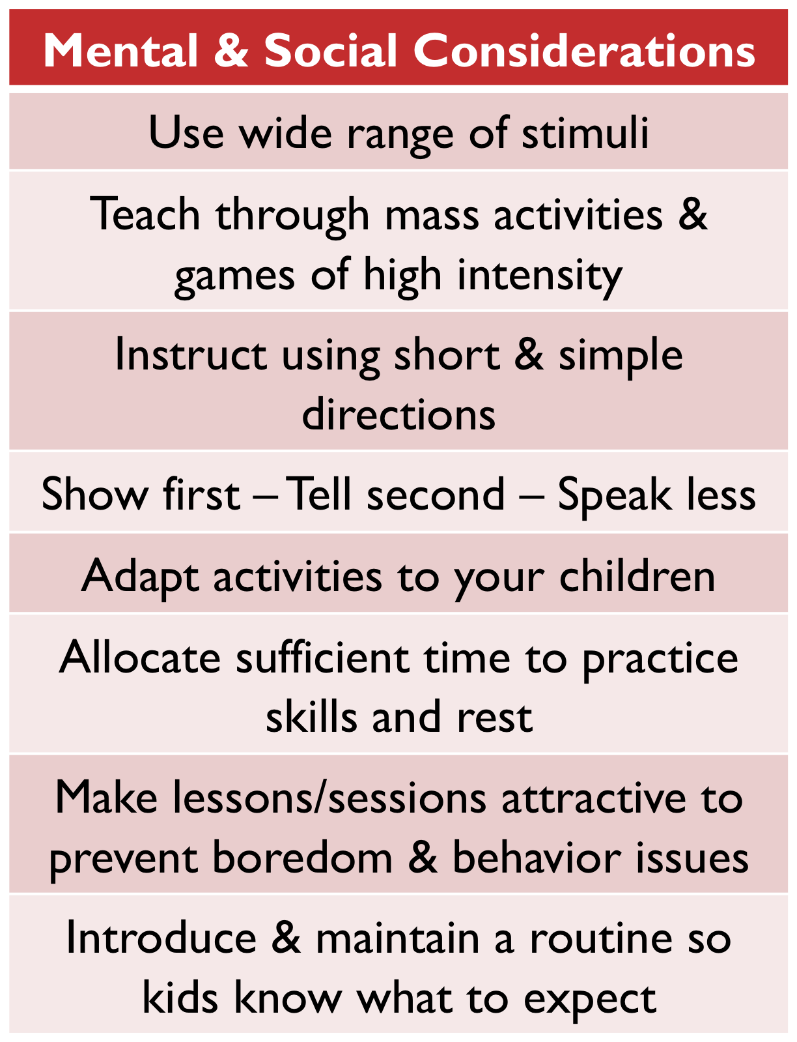
Core Teaching principles

Slide 11
Two ways to organize main part of the
Mini-Handball class or practice
Children are grouped by experience level
Children are grouped by age
Kids participate in activities that are chosen based on their ability, readiness & interests but within same methodological framework of 4 major content areas.
Kids circulate among coaches who lead specific training or stations that target specific motor and/or handball development skills.
Throwing & Passing &
Catching
Balancing & Jumping
Dribbling
Playing alone
& with others
Beginners
Intermediate
Advanced

Slide 12
Lead-Up Activities and Mini-Games
All fourteen (14) activities presented below meet the following set of criteria:
they are easy to organise and play but competitive in nature, require minimal equipment and set-up, can be easily adapted to almost any circumstances, provide learning and practicing opportunities for participants of various mastery levels, combine physical and skill practicing moments, stimulate continued participation and interest, and have added advantage of resembling number of key technical and tactical situations most often present during handball games.
Each lead-up game can be used as standalone unit (i.e., mini-tournament, festival, promo clinic, etc.) or be part of regular training session.
As the name “lead-up” suggests, these games usually follow general warm-up routines and precede precise technical/tactical drills planned for the practice’s main part.
To facilitate their practical applications, all games recommended here include short description of the idea and its main purpose, materials needed and field set-up diagram, variety notes and teaching tips.
However, they are not arranged by any specific criterion as depending on particularly set objectives, each game can freely molded to fit ones needs.
Enjoy, experiment, invent new versions & good luck in your daily practice!

Slide 13
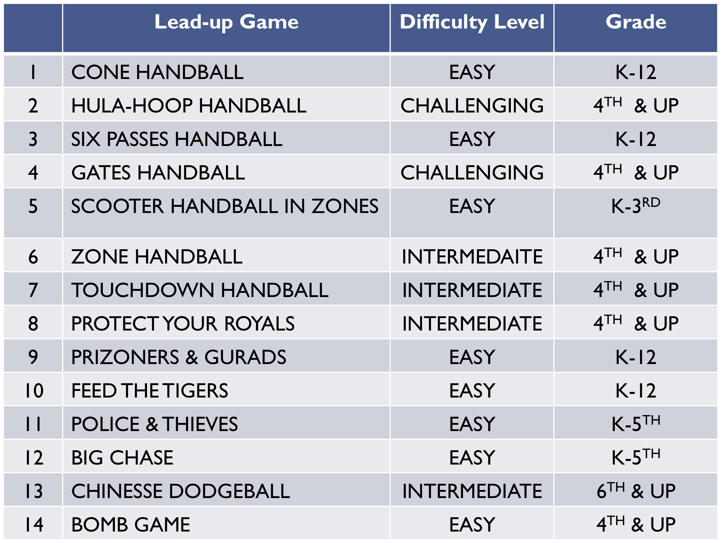
Selected Lead-Up Games

Slide 14
One Olympic Handball –
Worth Taking It To the Next Level
Elementary School
Junior High & Middle School
High School

Slide 15
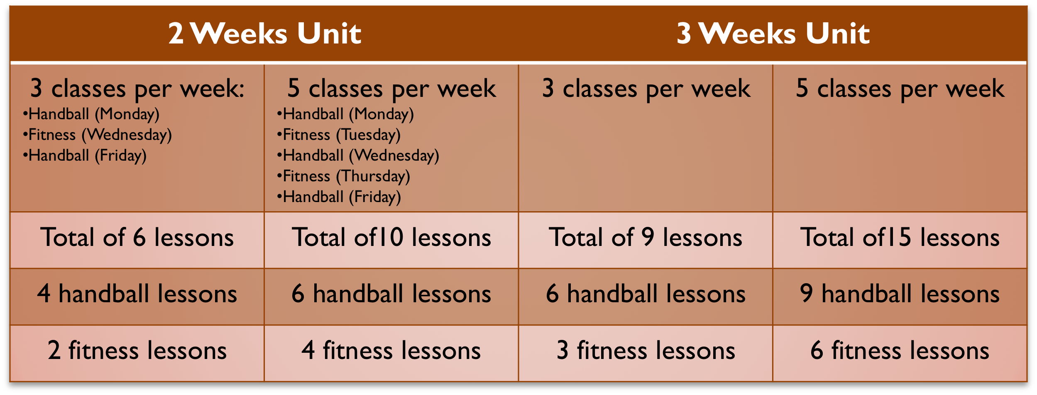
In-Class Handball Activities
Following recommendations are based on typical 2 or 3 week units with 3 to 5 classes per week, each lasting 45 minutes but including only 30 minutes of actual instruction time.
Each unit features both handball specific and general fitness component.
Of course, it is possible to model and adjust each unit not only to fit into your school’s curriculum but also your students’ needs.
Included are examples of single handball lesson and fitness lesson targeting fundamental motor and conditioning attributes.
Please see Slide 81 for more teaching resources containing innovative ideas and wide variety of simple but engaging exercises.

Slide 16
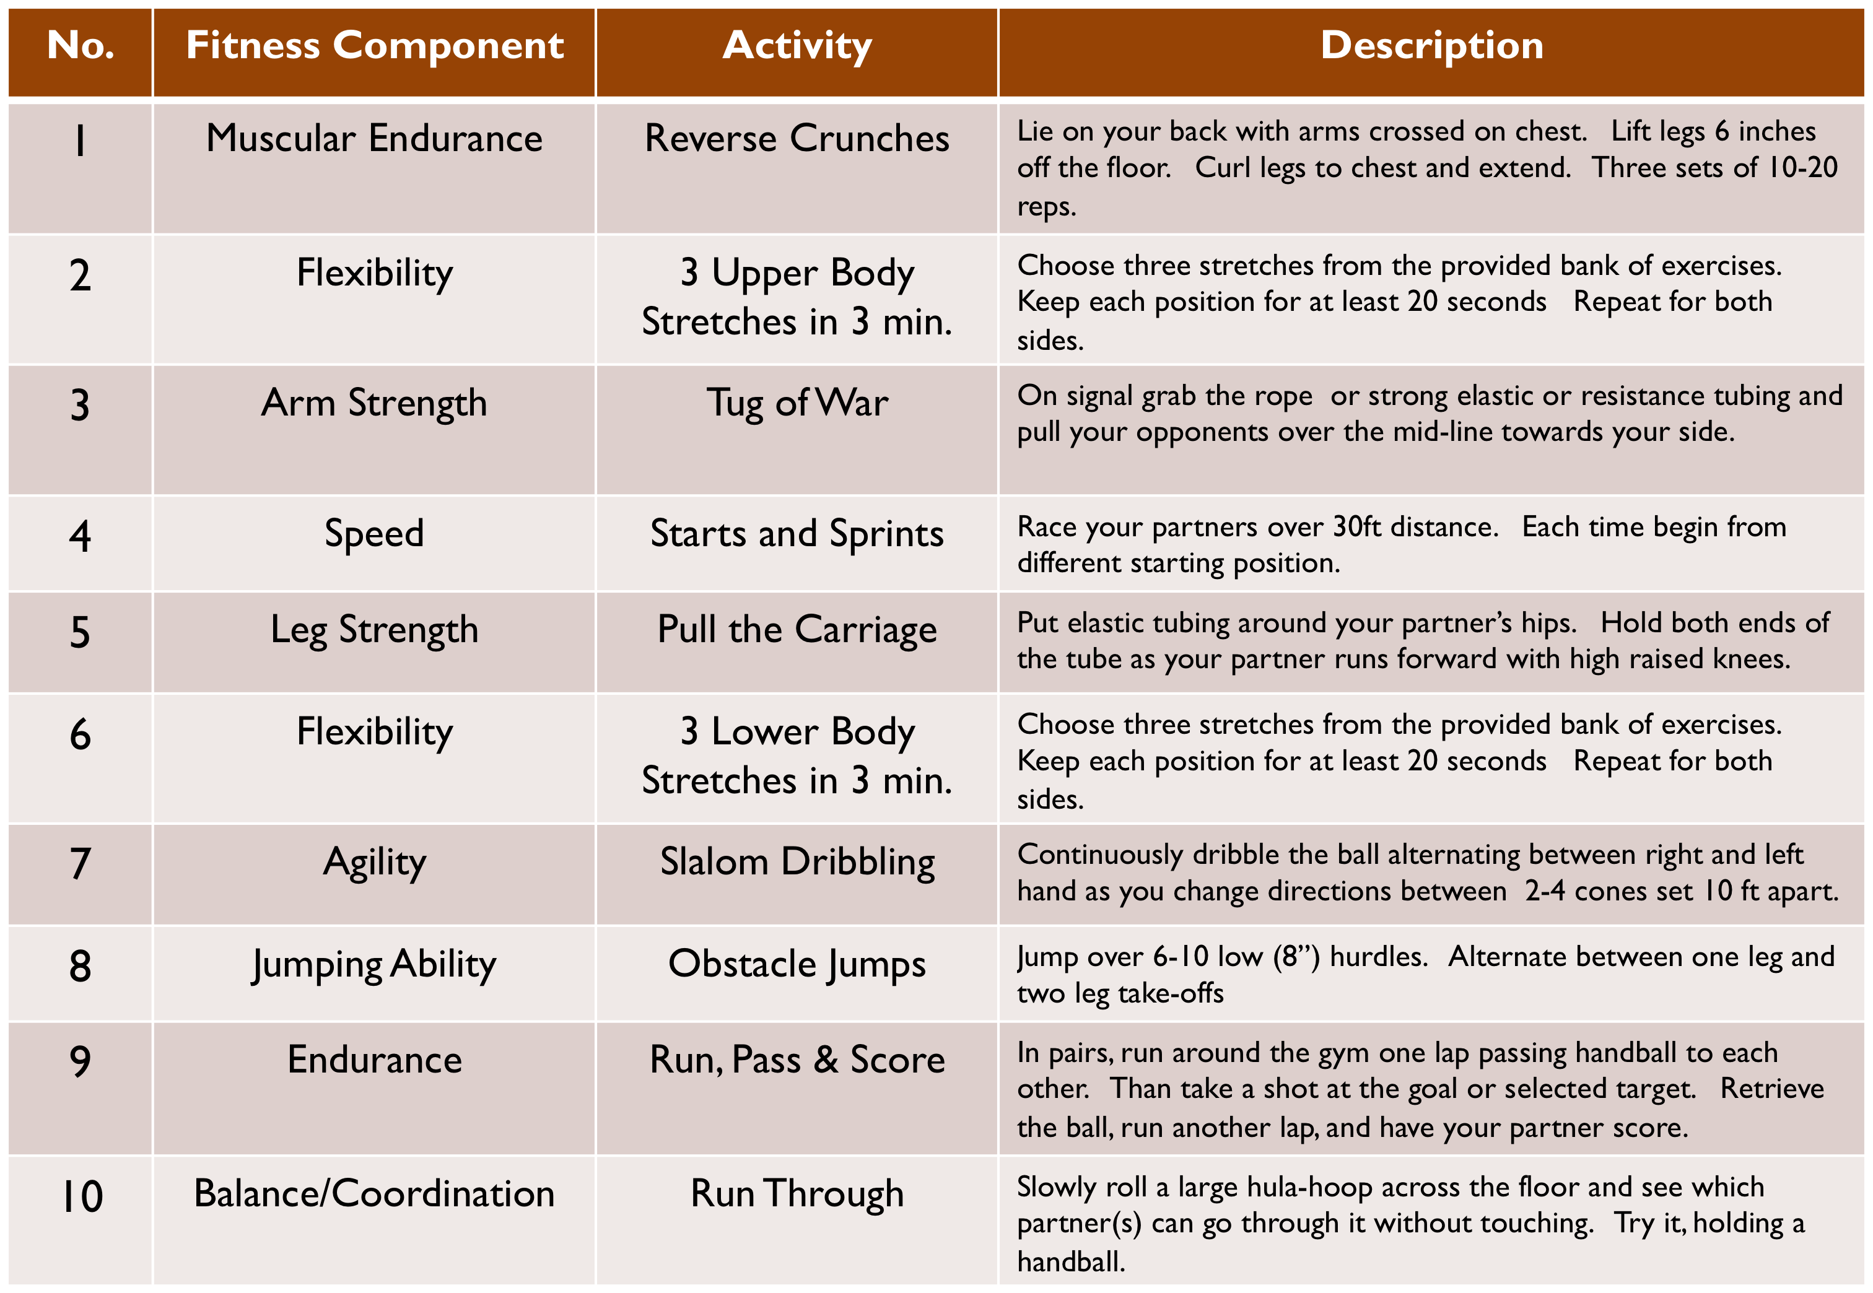
Handball – Fitness Day (30 minutes)
(Circuit Training :10 stations, 2-4 students per station)

Slide 17
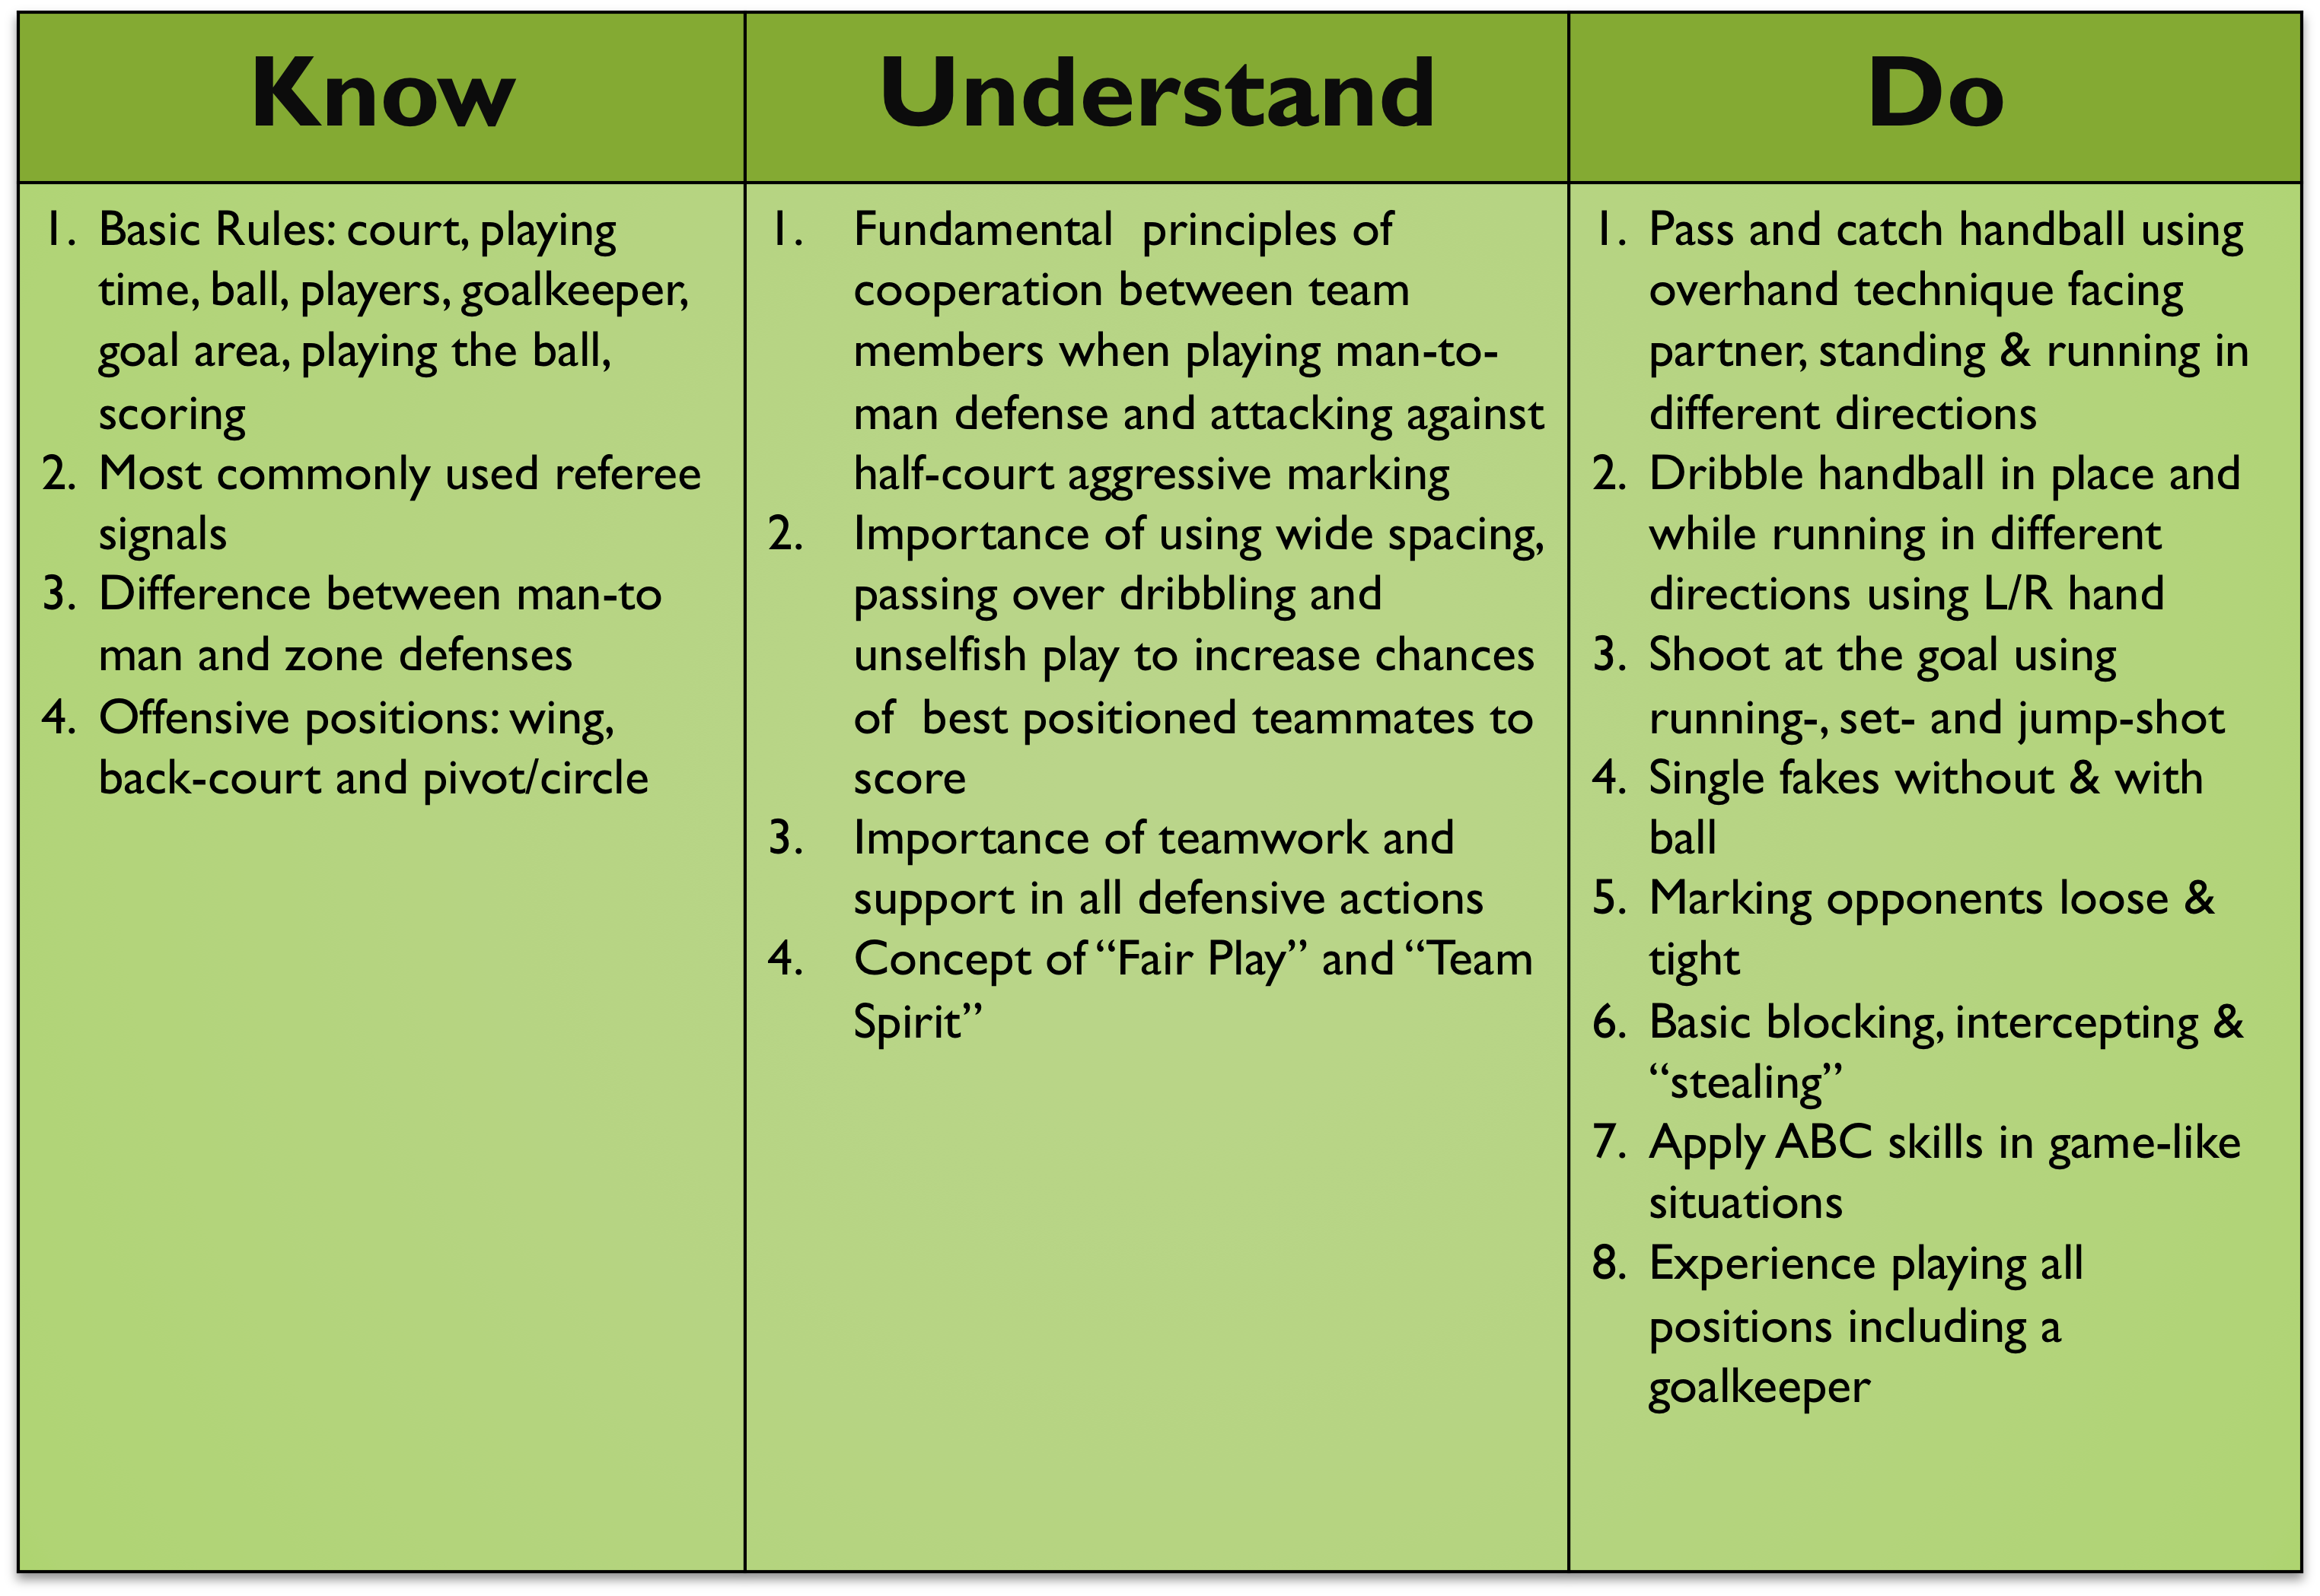
HANDBALL’S Know – Understand – Do Year 4

Slide 18
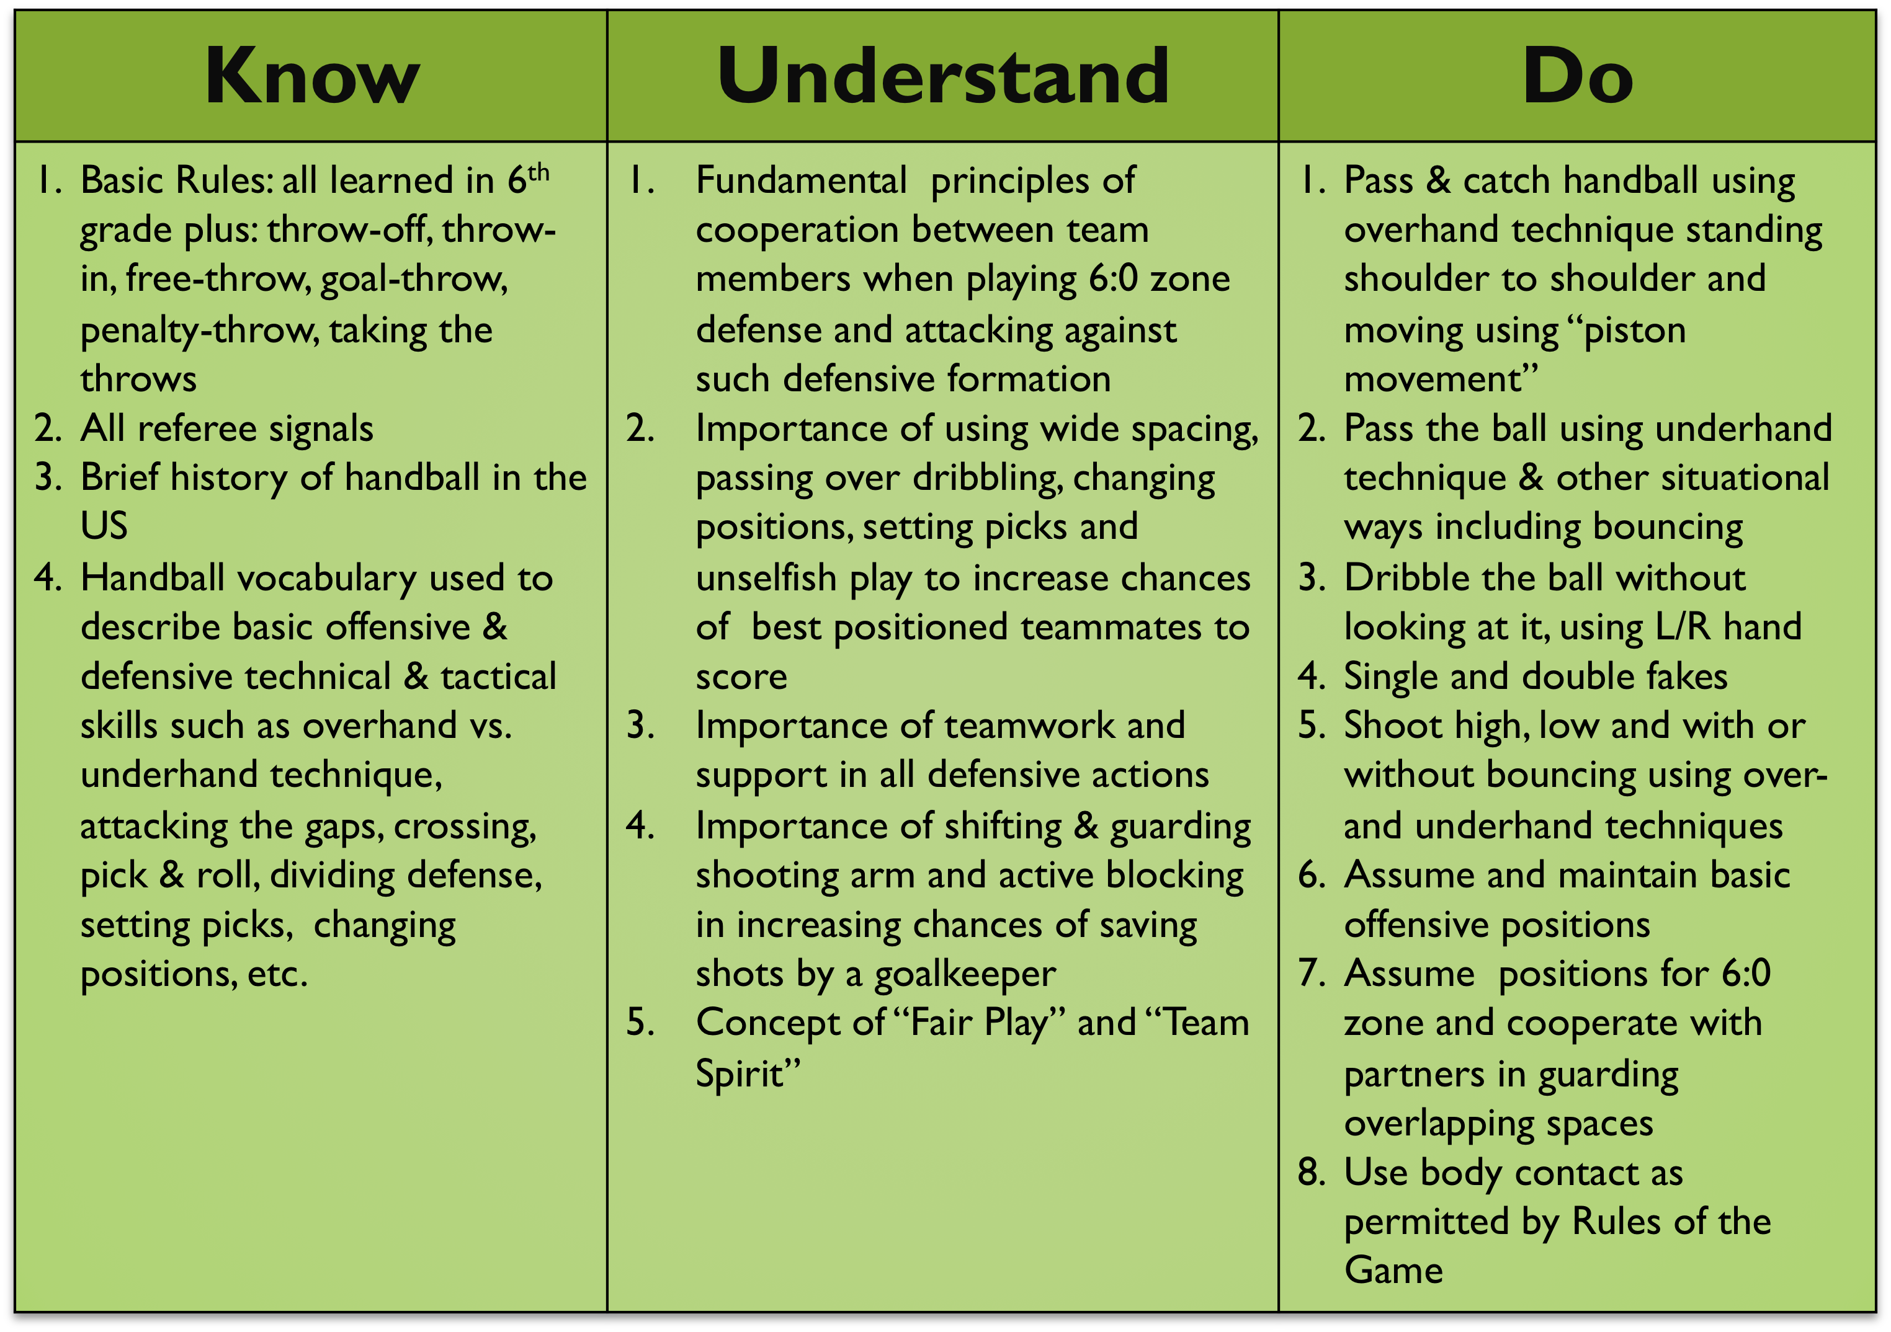
HANDBALL’S Know – Understand – Do (KUD) – Year 5

Slide 19
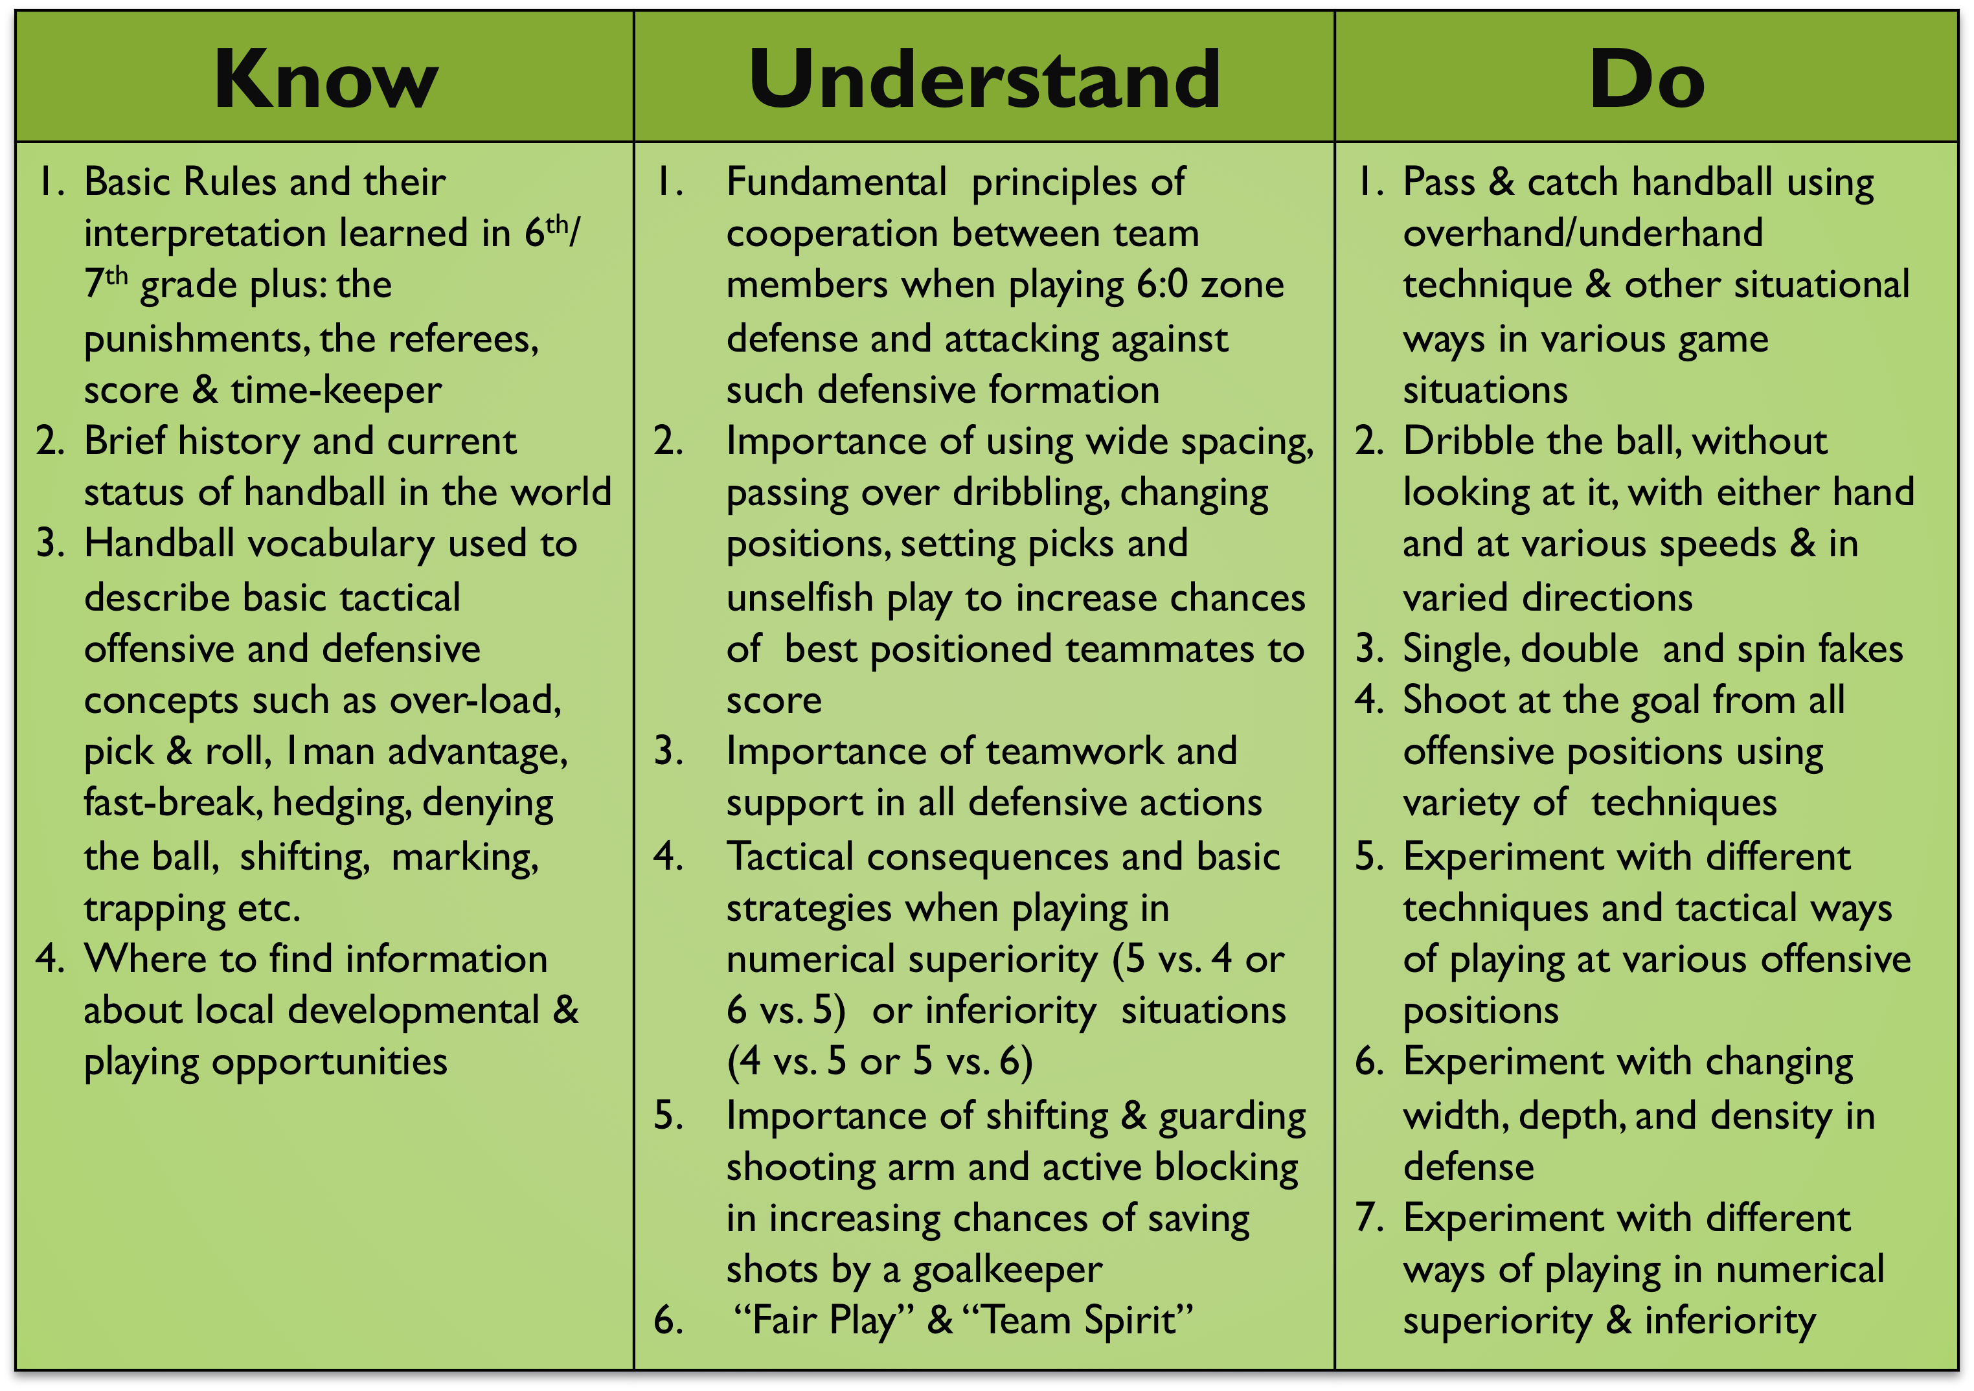
HANDBALL’S Know – Understand – Do (KUD) – Year 6

Slide 20
Individual Technical Skills
Individual Tactical Skills
Group & Team Tactics
Handball Fundamental Skills & Concepts
Offensive
Defensive
Offensive
Defensive
Offense:
1. Positional
2. Fast-break
Primary
Secondary
Defense:
1. Man-to-man
2. Zone
3. Quick Retreat

Slide 21
Fundamental Individual Technical Skills
Defense
Offense
Dribbling
Checking & Marking
1-on-1
Stealing & Intercepting
Blocking
Running Shot
Set Shot
Jump Shot
Single Fakes
Footwork
Overhand Passing/Catching
&
Piston Movement
Goalkeeping
Stance
Saving low, medium & high shots
Passing to counter-attack

Slide 22
Fundamental Individual Tactical Skills
Defense
Offense
Screening & Setting Picks
Reacting to fakes
Positioning
between attacker
& own goal
Switching
Changing Positions & Crossing
Supporting Teammates
Taking Over-
Passing On
Attacking
Gaps
Goalkeeping
Saving penalty shots
Forcing shots in preferable spots
Preventing fast-breaks

Slide 23
Fundamental Team Tactical Concepts
Defense
Offense
Against Zone
Defense
Zone:
3:3
5:1
6:0
Starting
Fast-break
Half-court
Man-to-Man
Against
Man-to-Man Defense
Goalkeeping
Reading the game & shooters
Communicating with defenders
Directing defense and blocking
Special
Situations
6 vs. 5
&
5 vs.6
Special Situations
6 vs. 5
&
5 vs. 6

Slide 24
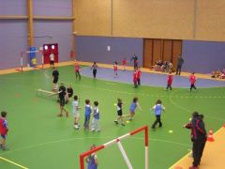
Mini-Handball Festival – Example
Girls & boys in co-ed 8-10 teams
Handball Queensland instructors, volunteer parents and hosting organization staff
Program: 10 stations rotation including
  Mini-handball court (1)
  Climbing wall or similar (2)
  Handball pyramid or substitute (3)
  7m target/accuracy throws on goal (4)
  Jump shots on mini goal (5)
  Mini-basketball court (6)
  Slalom dribbling - obstacle course (7)
  Alternative activity(free play with small apparatus such as balloons, hula-hoops, jump ropes, balance benches, etc. (8)
  Alternative activity with larger apparatus such as parachute, target board (9)
  Lead-up game with passing/catching (10)

Slide 25

Team Time-Out Cards

Slide 26
Warning Card (yellow) & Exclusion Card (red)

